Slide 1
A final question for you
Can Chinese dialects be called Chinese languages?

Slide 2
Various Chinese dialects = Various Chinese languages?

Slide 3


Slide 4
What is a dialect in linguistics textbook？
Dialect refers to a regional variety of a language spoken in a particular area
Size of the area does not matter; distinguished by differences in pronunciation, vocabulary, and grammar
The dialects or varieties of a particular language are closely related and, despite their differences, are most often largely mutually intelligible,

Slide 5




Are English, German, Dutch and Danish different languages or different dialects of the same language?

Slide 6
Indo-European languages

Slide 7
What is Chinese dialect？
Chinese dialect refers to a regional variety of the Chinese language spoken in a particular area
Size of the area does not matter; distinguished by differences in pronunciation, vocabulary, and grammar
The dialects or varieties of a particular language are closely related and, despite their differences, are most often largely mutually unintelligible,

Slide 8
Various Chinese dialects = Various Chinese languages!

Slide 9
Sinitic languages
link

Slide 10
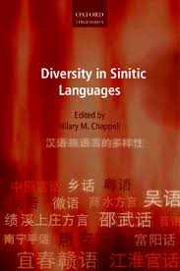
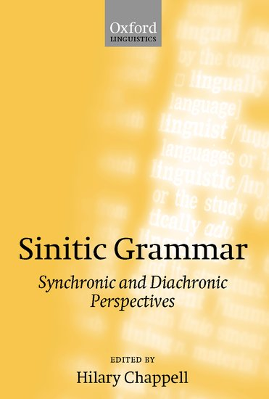

Slide 11
Sinitic languages
Cantonese language
Mandarin language
Min language
Hakka language
Various Chinese languages
Hokkien dialect
Teochew dialect

